Slide 1
Zomato Sales Analysis
File created on: 4/24/2024 9:43:51 AM

Slide 2
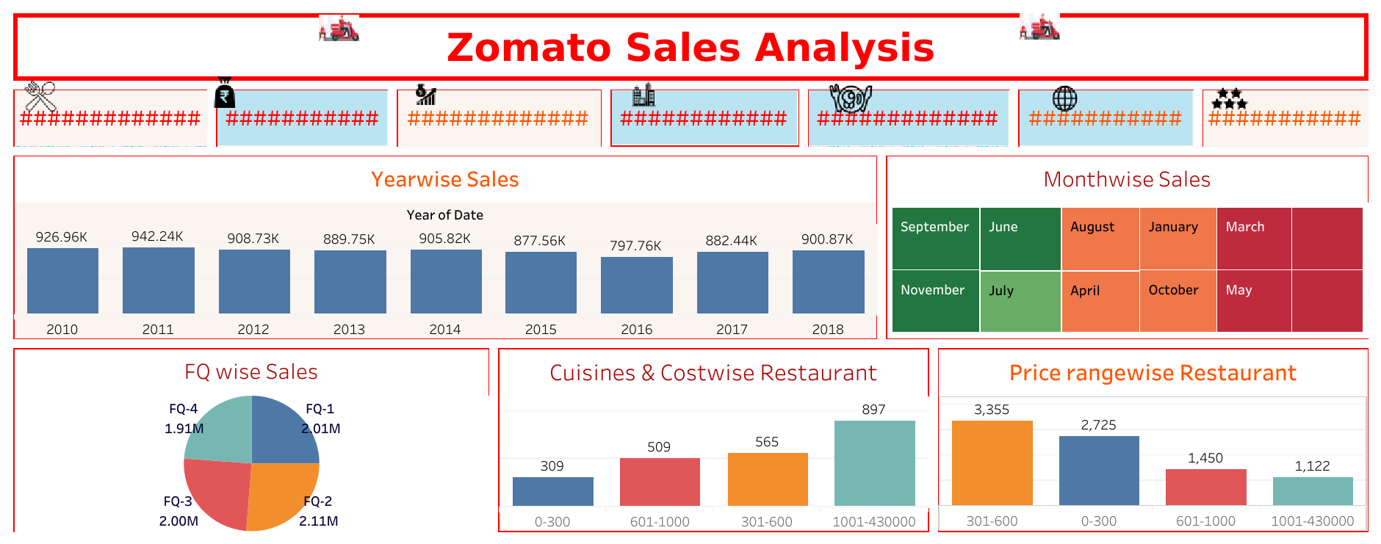

Slide 3
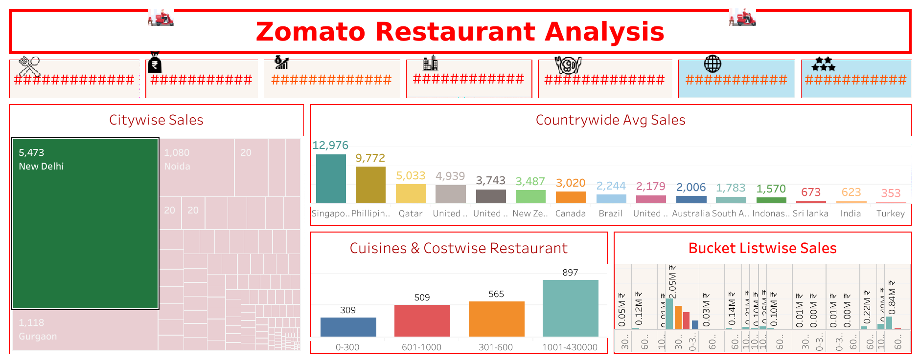

Slide 4
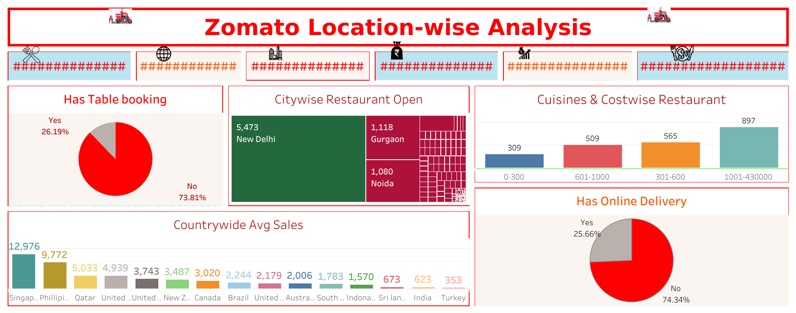

Slide 5
